Slide 1
VIP Dashboard – Product Roadmap
October 30, 2019

Slide 2
Purpose and Agenda
Purpose: To describe the current planned “Roadmap” for the VIP Dashboard and solicit input from leadership on direction and the desired end-state for the VIP Dashboard
Agenda:
VIP Background
Requirements: What We Think We Understand
Current Roadmap
Short Term
Mid Term
Long Term
Recommendation(s)
Guidance?

Slide 3
VIP Dashboard Overview
Background
The VIP Dashboard was created for VA to:
Assist the governance process of VA’s IT investments in achieving their intended outcomes on time and within budget
Support VA’s mission and business objectives, and offer the appropriate security and privacy protections in accordance with OIG standards
Conform to legislative mandates and Office of Management and Budget (OMB) requirements for IT investment management (OMB Exhibit 300-B)
Technology
.NET framework custom application (C#, JQuery, SQL, etc) running on a windows server in the VA SharePoint environment.
Runs on SharePoint server to leverage Security Groups and Authentication.
Important to note that while it runs on SharePoint, it is not a SharePoint application.

Slide 4
VIP Dashboard Overview
Organizations and Tools Using VIP Dashboard and Data
Organization | VA User | Purpose
EPMD | Dev PMs, Secondary Contacts, Additional Users who are assigned data entry for projects | Overall Project Reporting (examples: Schedule, Budget, and Risk Reporting)
VA POPM | Jeff Hudgins Donna Quinn Investment Analysts | OMB Reporting, Investment Reporting, Enterprise Project Structure (EPS) management
VA Quality Performance & Risk (QPR) | Jack C.W. Yang John Preston Nathan Tierney Other QPR support members | OMB TechStat Reporting (Per OMB VA must reestablish/report TechStats)
EPMO QA/Reporting & Analysis | Tracy Morgan Nelson Love Other QA/Reporting & Analysis members | Reporting for Portfolios/CIO/PDAS/EPMO DAS
 | VA Tools
OIT EPMD | EPMD Tool | Adds more granular qualitative data to information found in VIP Dashboard
VA QPR | CIO’s Balanced Scorecard | 6 Areas (Mission Essential, Financial, Process, Employee, Learning and Growth, Veteran) 32 Metrics (10 sourced from VIP Dashboard)
VA QPR | PMR Dashboard
Notes:
10 Metrics come from VIP
Number of Projects per Project Manager
Major IT Investments Meeting 90% or More of Perf. Targets
Progress toward meeting strategic objectives
Product Releases by Month
Projects within +/- 10% of Budget
Projects Within +/- 10% of Schedule
% of OMB Investments with Innovation Measure
% of Investments with Innovation Measure being Met
% of OIT Projects that are Vet-Facing
Number of Investments by Risk Level

Slide 5
Requirements: What We Think We Understand
1) There is a question around the requirement for OMB Reporting
2) There is a desire for:
Expanded/Custom Reporting
Analyzed multiple tools (Pyramid, Tableau, Power BI, MS SSRS, etc)
Enhance capabilities for daily management
More visibility of project execution
Project statuses, explanations, etc
Better Metrics
Leading indicators of project performance
Developed and Implemented KPIs (Tracey wants KPIs back)
Improved functionality, look/feel
Visual Display of health
Smart Search
A single tool for all VA IT project level info
Integrate with other systems for other desired info?

Slide 6
Roadmap
Short Term Plan
Next 2 Sprints
Mid Term Plan
Next 3-6 months
Long Term Plan
12 Months

Slide 7
Short Term Plan
Conduct VIP Dashboard “Discovery”
Better understand leadership requirements (Director ACOE, Placemat Consumers, CIO, etc)
Better understand other users requirements (Dev PMs, Other Stakeholders)
Identify better/more meaningful metrics
Research improved tools to meet requirements coming from discovery
SmartSheet, Power BI, GSA Folio
Add “Status Update” functionality from EPMD Tool to VIP Dashboard
Landing page for VIP Dashboard
Quick Links to different Modules
Ability to Drag and Drop
Add personalization option
Personalize Dashboard
Save personalization in database
Meet with Director ACOE /Others
Interview Dev PMs
Review Balanced Score Card
Talk to SAFe SMEs
Meet with SmartSheet, Research Power BI and GSA Folio
Need better understanding of what’s desired and to identify better metrics (see “Discovery” above)

Slide 8
Example Of Highly Meaningful DEVOPS Metrics
In a study outlined in the book “The Science of Lean Software and DEVOPS, Accelerate, Building and Scaling High Performing Technology Organizations,” the below are recommended as the most effective/useful metrics over typical metrics like Productivity, Velocity, and Utilization
 | Lean/Agile Metric | Description | Attainability
Tempo | Lead time for changes | The time it takes to go from code committed to code successfully running in production. According to the DORA 2018 Report, Elite performers have a lead time for changes of less than 1 hour and Low performers have a lead time for changes that is between 1 month and 6 months.
 | Deployment frequency | Proxy for batch size since it is easy to measure and typically has low variability. By “deployment” we mean a software deployment to production or to an app store.” The reason the frequency of production deployments matters is because it tells you how often you’re delivering something of value to end users and/or getting feedback from users.
Quality | Time to restore service | The time to restore service or mean time to recover (MTTR) metric calculates the average time it takes to restore service.
 | Change failure rate | The change failure rate is a measure of how often deployment failures occur in production that require immediate remedy (particularity, rollbacks). According to the DORA 2018 Report, Elite performers have a change failure rate between 0-15% and Low performers have a rate from 46-60%.

Slide 9
Mid Term Plan
Custom reporting
Integrate with Data Warehouse team
Add standard Power BI reports or SmartSheet
Add Custom Reporting option
Add Online Help
Frequently Asked Questions
VIP Dashboard Module help information
DEVOPS Workflow
Rebranding Dashboard to PLM/DEVOPS/SAFe
Reporting implementation depends on technology Discovery findings (Power BI, SmartSheet, Folio, etc)

Slide 10
Long Term Plan
VIP Dashboard Technology Upgrade
Upgrade SharePoint 13 to Microsoft Office 365
Migrate to Cloud to support DevOps initiative
Implement CI/CD pipeline
Expose VIP Dashboard API for integration with other tools
Technology Upgrade depends on Discovery Findings
(Power BI, SmartSheets, Folio, etc)

Slide 11
Integration Technology
Tool | Purpose | Notes
SmartSheet | Process Enablement Custom Dashboards Project Management | Cannot replicate current dashboard functionality Can provide/facilitate process framework Dashboard from processes Cost: $735 per admin per year Integration: APIs to many existing tools
Power BI | Business Analytics Service Custom Reports Dashboards Views | QA/RA Dashboard Prototype in 2-3 Weeks Already Purchased
Folio | OMB Reporting | Replaces eCPIC which is the Government wide tool for OMB 300A submissions Begin Loading Data 5/2020 Actual use for 300A is 2/2021 Cost: 330K/yr (already covered by 300A) + Migration Cost TBD 300B Migration earliest date 2/2021

Slide 12
Recommendations
Make VIP Dashboard authoritative data source
Leading Indicators
Bring back KPIs
Ability for PMs to flag issues in advance of problems
Make “Risks” more granular (ie increment level)
Implement already available tech (ie Power BI for custom reports)
Determine processes and metrics for DEVOPS/SAFe/PLM first then implement tooling to guide PMs through processes and harvest data along the way

Slide 13
Guidance?
Director’s desire/vision for the tool?

Slide 14
Back Up Slides

Slide 15
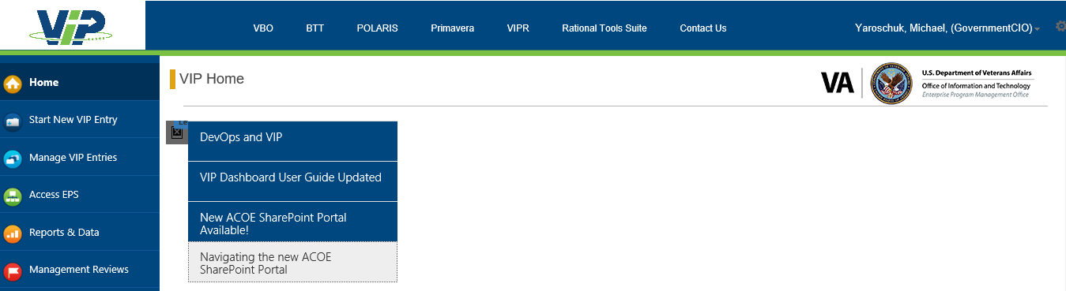
Placemat Splash Page
 | EPMD | Health Services | Benefits and Memorial Services | Technology and Platform Services | Veteran Experience Services | Corp Svcs | NPL
Projects in Product Phase | 76 | 34 | 10 | 11 | 14 | 6 | 1
Number of Projects Releasing within 3 Months | 45 | 23 | 7 | 2 | 11 | 2 | 0
Releases to Production within 3 Months | 36 | 18 | 6 | 1 | 9 | 2 | 0
Releases to IOC within 3 Months | 4 | 4 | 0 | 0 | 0 | 0 | 0
Within 3 Months of Product Phase Start | 5 | 1 | 1 | 1 | 2 | 0 | 0
% of Projects Releasing in 3 Months or Less | 59% | 68% | 70% | 18% | 79% | 33% | 0%
Number of Projects Not Releasing within 3 Months | 23 | 5 | 3 | 8 | 3 | 3 | 1
Release to Pre-Prod | 8 | 6 | 0 | 1 | 0 | 1 | 0
Releases to Test within 3 Months | 0 | 0 | 0 | 0 | 0 | 0 | 0
More than 3 months since last Release | 23 | 5 | 3 | 8 | 3 | 3 | 1
 | EPMD | Health Services | Benefits and Memorial Services | Technology and Platform Services | Veteran Experience Services | Corporate Services | NPL
Projects in Product Phase | 76 | 34 | 10 | 11 | 14 | 6 | 1
Release to Pre-Prod, IOC, or Production in < 1 Month | 30 | 17 | 4 | 2 | 5 | 2 | 0
% of Projects Releasing to Pre-Prod, IOC, or Production in 1 Month | 39% | 50% | 40% | 18% | 36% | 33% | 0%

Slide 16
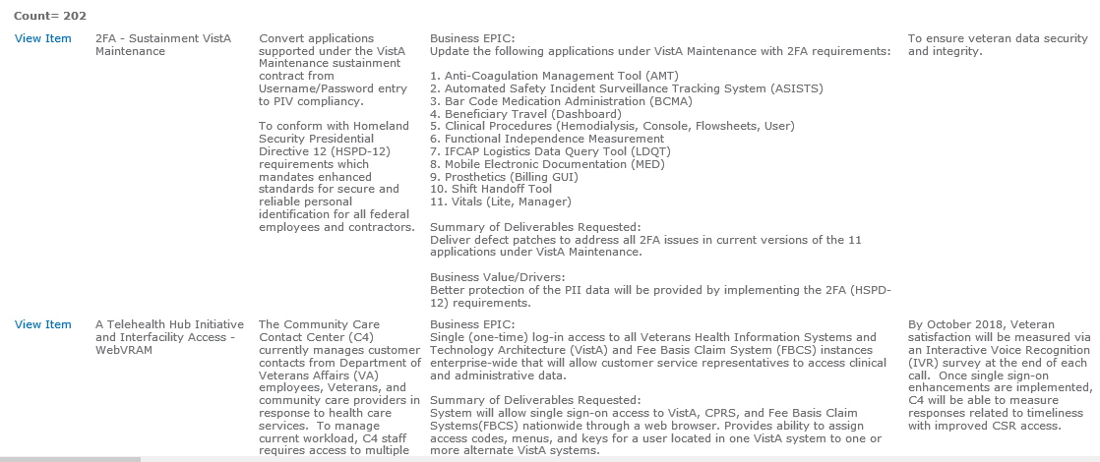
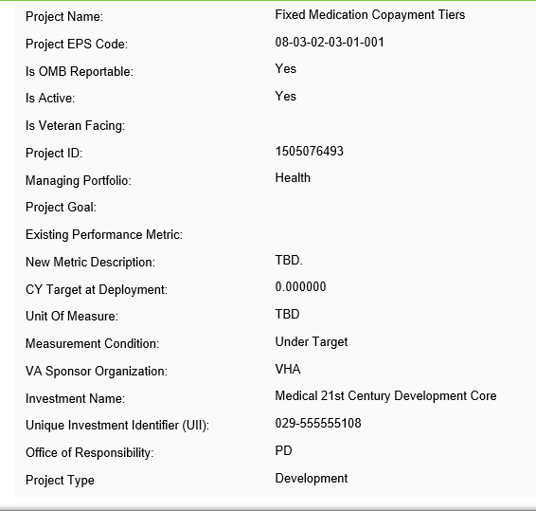
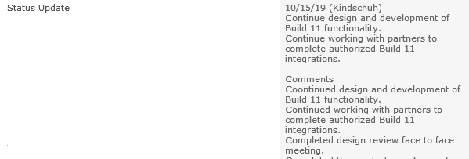

Short Term Plan – Tool Consolidation
EPMD Tool
VIP Dashboard

Slide 17
Short Term Plan – Consolidation, Look, and Feel
Convert applications supported under the VistA Maintenance sustainment contract from Username/Password entry to PIV compliancy. To conform with Homeland Security Presidential Directive 12 (HSPD-12) requirements which mandates enhanced standards for secure and reliable personal identification for all federal employees and contractors.
06/22/18 (Caulfield) Per Vanessa Davis, reporting has been stopped as of 6/22/18 as this is part of Health Product Support Sustainment defect remediation work and not project related. Closing this item. @@@@ 06/15/18 (Caulfield) Upcoming Schedule Highlights: Application: Anti-Coagulation Management Tool Patch: OR*3*447 Status: Nationally released on February 20, 2018. --- Application: Automated Safety Incident Surveillance Tracking System (ASISTS) Patch: OOPS*2*29 Status: Nationally released on March 31, 2017. On August 11, 2017 the compliance date was changed from August 20, 2017 to September 30, 2017 to meet the System Center Configuration Manager (SCM) packaging timeframe for the Graphical User Interface (GUI) that accompanies this VistA patch which was released with a compliance date of October 26, 2017.

Slide 18
Example Production Metrics
Metric | Description
Change failure rate | The change failure rate is a measure of how often deployment failures occur in production that require immediate remedy (particularity, rollbacks). To obtain this information in an AWS-native manner, you track each deployment and indicate whether it was successful or not. Then, you track the ratio of successful to unsuccessful deployments to production over time. According to the DORA 2018 Report, Elite performers have a change failure rate between 0-15% and Low performers have a rate from 46-60%.
Continuous Improvement | Not widely/consistently used. We even open sourced a CloudWatch Dashboard for deployment pipelines that use CodePipeline that captures some of these metrics along with some others. It’s called pipeline-dashboard. A way to obtain these metrics is through brief surveys and by instrumenting the deployment pipelines for certain applications/services. This way you can ensure teams are seeing improvements and, if they are not, identify ways to remedy this. Then, you might anonymize this data and make it available across an enterprise. This helps ensure you are accelerating the speed and confidence of feedback between end users and developers.

